Slide 1

Chapter 4
Defining Classes I
Slides prepared by Rose Williams, Binghamton University
Kenrick Mock, University of Alaska Anchorage
Copyright © 2016 Pearson Inc. All rights reserved.

Slide 2
Introduction
Classes are the most important language feature that make object-oriented programming (OOP) possible
Programming in Java consists of defining a number of classes
Every program is a class
All helping software consists of classes
All programmer-defined types are classes
Classes are central to Java

Slide 3
A Class Is a Type
A class is a special kind of programmer-defined type, and variables can be declared of a class type
A value of a class type is called an object or an instance of the class
If A is a class, then the phrases "bla is of type A," "bla is an object of the class A," and "bla is an instance of the class A" mean the same thing
A class determines the types of data that an object can contain, as well as the actions it can perform

Slide 4
Primitive Type Values vs. Class Type Values
A primitive type value is a single piece of data
A class type value or object can have multiple pieces of data, as well as actions called methods
All objects of a class have the same methods
All objects of a class have the same pieces of data (i.e., name, type, and number)
For a given object, each piece of data can hold a different value

Slide 5
The Contents of a Class Definition
A class definition specifies the data items and methods that all of its objects will have
These data items and methods are sometimes called members of the object
Data items are called fields or instance variables
Instance variable declarations and method definitions can be placed in any order within the class definition

Slide 6
The new Operator
An object of a class is named or declared by a variable of the class type:
ClassName classVar;
The new operator must then be used to create the object and associate it with its variable name:
classVar = new ClassName();
These can be combined as follows:
ClassName classVar = new ClassName();
Reference
Object

Slide 7
Instance Variables and Methods
Instance variables can be defined as in the following two examples
Note the public modifier (for now):
public String instanceVar1;
public int instanceVar2;
In order to refer to a particular instance variable, preface it with its object name as follows:
objectName.instanceVar1
objectName.instanceVar2

Slide 8
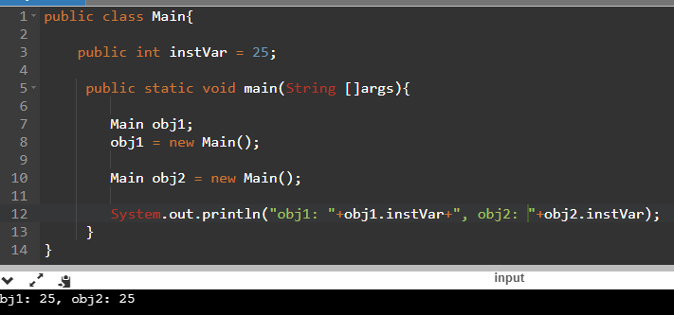
Example

Slide 9
Instance Variables and Methods
Method definitions are divided into two parts: a heading and a method body:
public void myMethod() Heading
{
code to perform some action Body
and/or compute a value
}
Methods are invoked using the name of the calling object and the method name as follows:
classVar.myMethod();
Invoking a method is equivalent to executing the method body

Slide 10
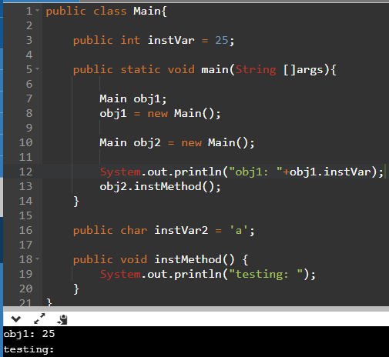
Example

Slide 11
More About Methods
There are two kinds of methods:
Methods that compute and return a value
Methods that perform an action
This type of method does not return a value, and is called a void method
Each type of method differs slightly in how it is defined as well as how it is (usually) invoked

Slide 12
More About Methods
A method that returns a value must specify the type of that value in its heading/signature:
public typeReturned methodName(paramList)
A void method uses the keyword void in its heading to show that it does not return a value :
public void methodName(paramList)

Slide 13
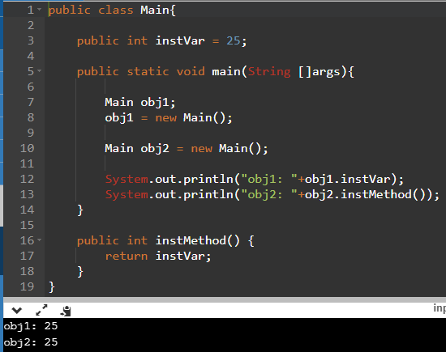
Example

Slide 14
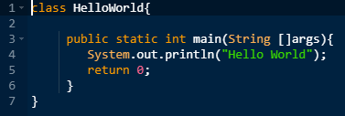
iClicker Time
What’s wrong with this code?
Nothing
main() must be void
class must be public
Both B and C

Slide 15
return Statements
The body of both types of methods contains a list of declarations and statements enclosed in a pair of braces
public <void or typeReturned> myMethod()
{
declarations
statements
}
Body

Slide 16
return Statements
The body of a method that returns a value must also contain one or more return statements
A return statement specifies the value returned and ends the method invocation:
return Expression;
Expression can be any expression that evaluates to something of the type returned listed in the method heading

Slide 17
return Statements
A void method need not contain a return statement, unless there is a situation that requires the method to end before all its code is executed
In this context, since it does not return a value, a return statement is used without an expression:
return;

Slide 18
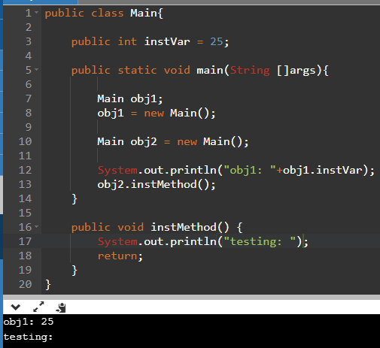
Example

Slide 19
Method Definitions
An invocation of a method that returns a value can be used as an expression anyplace that a value of the typeReturned can be used:
typeReturned tRVariable;
tRVariable = objectName.methodName();
An invocation of a void method is simply a statement:
objectName.methodName();

Slide 20
Any Method Can Be Used As a void Method
A method that returns a value can also perform an action
If you want the action performed, but do not need the returned value, you can invoke the method as if it were a void method, and the returned value will be discarded:
objectName.returnedValueMethod();

Slide 21
Local Variables
A variable declared within a method definition is called a local variable
All variables declared in the main method are local variables
All method parameters are local variables
If two methods each have a local variable of the same name, they are still two entirely different variables

Slide 22
Global Variables
Some programming languages include another kind of variable called a global variable
The Java language does not have global variables

Slide 23
Blocks
A block is another name for a compound statement, that is, a set of Java statements enclosed in braces,{}
A variable declared within a block is local to that block, and cannot be used outside the block
Once a variable has been declared within a block, its name cannot be used for anything else within the same method definition

Slide 24
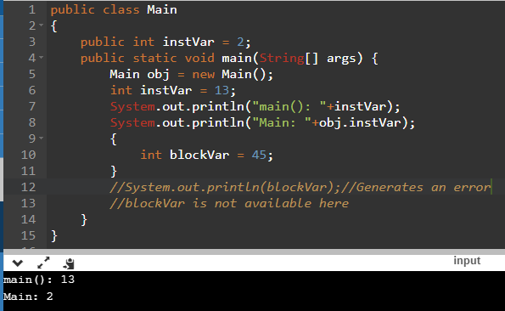
Example: Local variables

Slide 25
Declaring Variables in a for Statement
You can declare one or more variables within the initialization portion of a for statement
A variable so declared will be local to the for loop, and cannot be used outside of the loop
If you need to use such a variable outside of a loop, then declare it outside the loop

Slide 26
Parameters of a Primitive Type
The methods seen so far have had no parameters, indicated by an empty set of parentheses in the method heading
Some methods need to receive additional data via a list of parameters in order to perform their work
These parameters are also called formal parameters

Slide 27
Parameters of a Primitive Type
A parameter list provides a description of the data required by a method
It indicates the number and types of data pieces needed, the order in which they must be given, and the local name for these pieces as used in the method
public double myMethod(int p1, int p2, double p3)

Slide 28
Parameters of a Primitive Type
When a method is invoked, the appropriate values must be passed to the method in the form of arguments
Arguments are also called actual parameters
The number and order of the arguments must exactly match that of the parameter list
The type of each argument must be compatible with the type of the corresponding parameter
int a=1,b=2,c=3;
double result = myMethod(a,b,c);

Slide 29
Parameters of a Primitive Type
In the preceding example, the value of each argument (not the variable name) is plugged into the corresponding method parameter
This method of plugging in arguments for formal parameters is known as the call-by-value mechanism

Slide 30
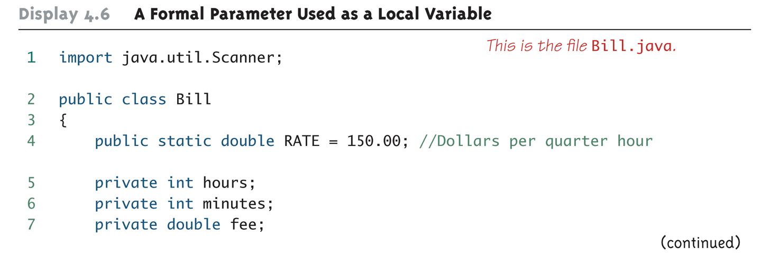
A Formal Parameter Used as a Local Variable (Part 1 of 5)
What are these?
Variables
Members
Instance variables
All above
None of the above

Slide 31
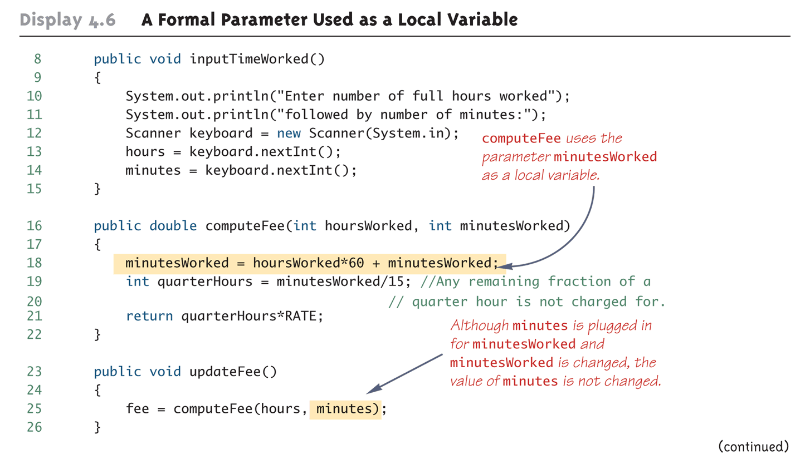
A Formal Parameter Used as a Local Variable (Part 2 of 5)

Slide 32
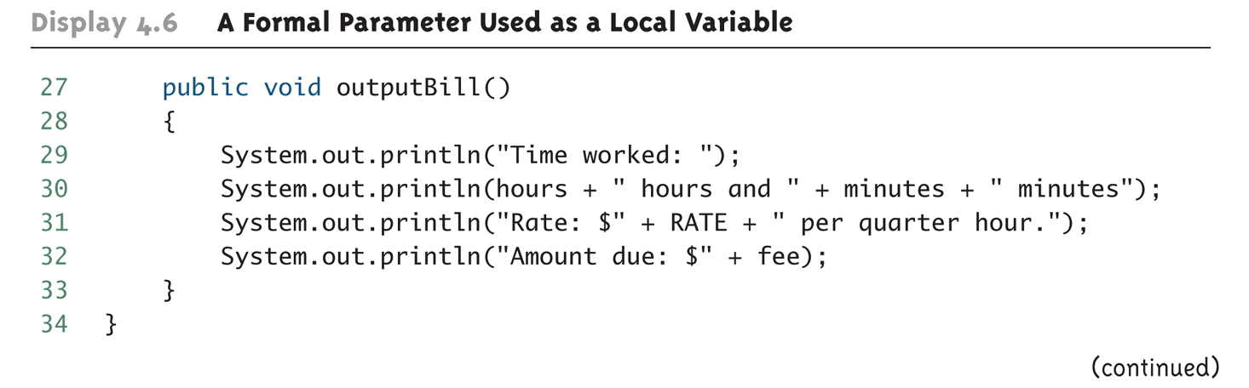
A Formal Parameter Used as a Local Variable (Part 3 of 5)

Slide 33
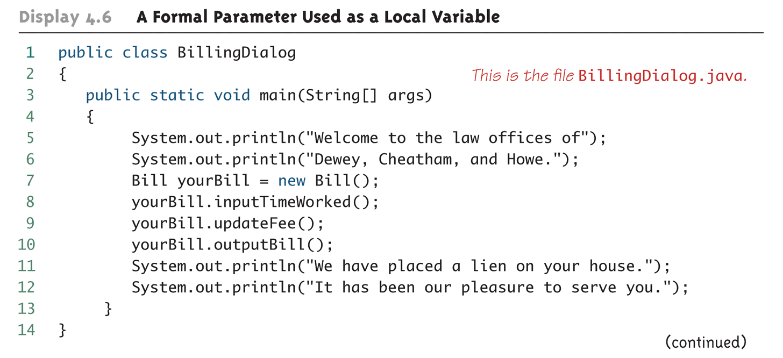
A Formal Parameter Used as a Local Variable (Part 4 of 5)

Slide 34
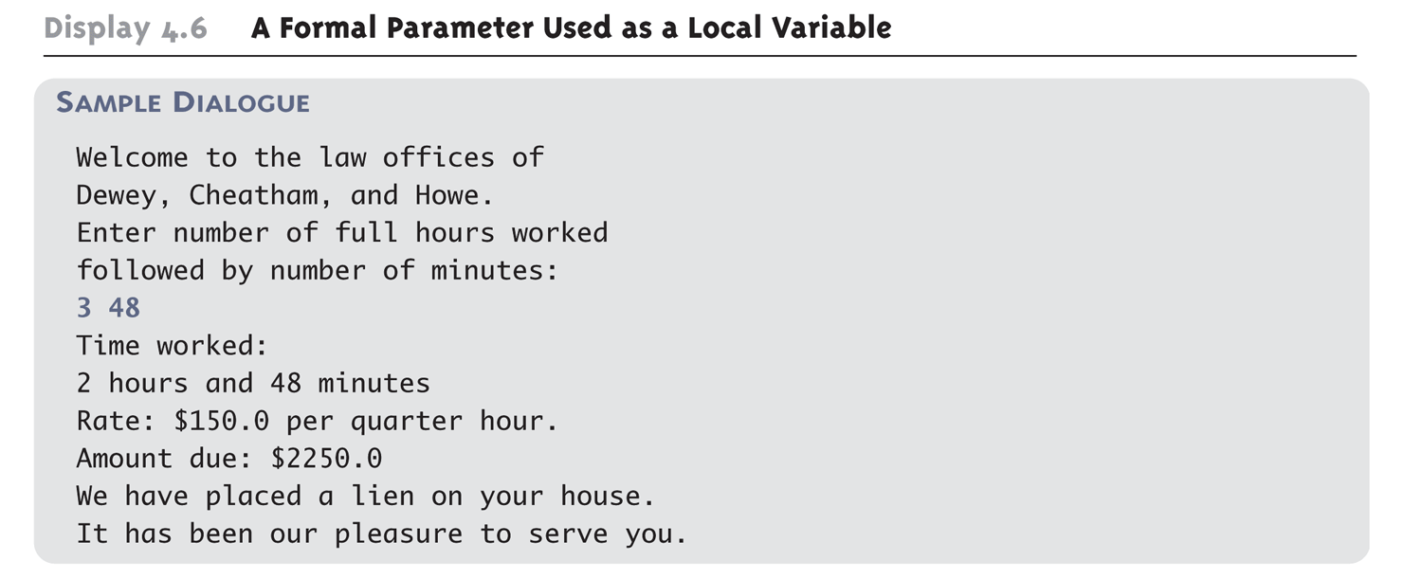
A Formal Parameter Used as a Local Variable (Part 5 of 5)

Slide 35
Accessor and Mutator Methods
Accessor methods allow the programmer to obtain the value of an object's instance variables
The data can be accessed but not changed
The name of an accessor method typically starts with the word get
Mutator methods allow the programmer to change the value of an object's instance variables in a controlled manner
Incoming data is typically tested and/or filtered
The name of a mutator method typically starts with the word set

Slide 36
Mutator Methods Can Return a Boolean Value
Some mutator methods issue an error message and end the program whenever they are given values that aren't sensible
An alternative approach is to have the mutator test the values, but to never have it end the program
Instead, have it return a boolean value, and have the calling program handle the cases where the changes do not make sense

Slide 37
Constructors
A constructor is a special kind of method that is designed to initialize the instance variables for an object:
public ClassName(anyParameters){code}
A constructor must have the same name as the class
A constructor has no type returned, not even void
Constructors are typically overloaded

Slide 38
Constructors
A constructor is called when an object of the class is created using new
ClassName objectName = new ClassName(anyArgs);
The name of the constructor and its parenthesized list of arguments (if any) must follow the new operator
This is the only valid way to invoke a constructor: a constructor cannot be invoked like an ordinary method
If a constructor is invoked again (using new), the first object is discarded and an entirely new object is created
If you need to change the values of instance variables of the object, use mutator methods instead

Slide 39
You Can Invoke Another Method in a Constructor
The first action taken by a constructor is to create an object with instance variables
Therefore, it is legal to invoke another method within the definition of a constructor, since it has the newly created object as its calling object
For example, mutator methods can be used to set the values of the instance variables
It is even possible for one constructor to invoke another

Slide 40
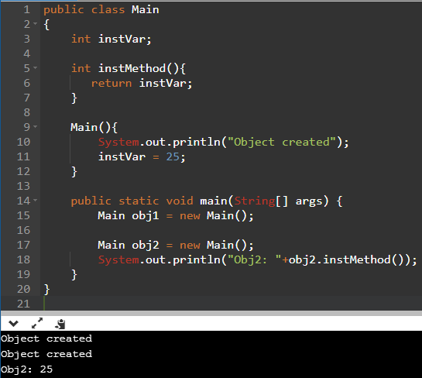
Example: Constructor

Slide 41
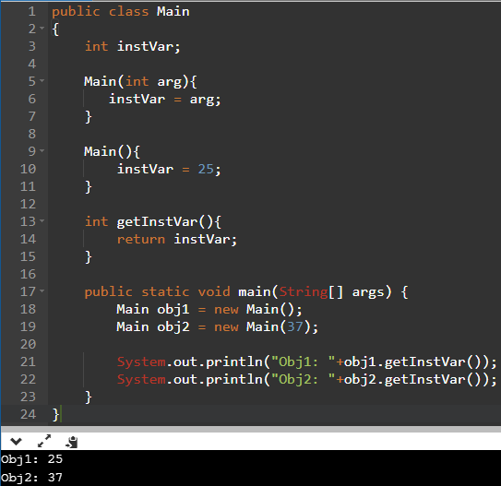
Example: Constructor

Slide 42
Information Hiding and Encapsulation
Information hiding is the practice of separating how to use a class from the details of its implementation
Abstraction is another term used to express the concept of discarding details in order to avoid information overload
Encapsulation means that the data and methods of a class are combined into a single unit (i.e., a class object), which hides the implementation details
Knowing the details is unnecessary because interaction with the object occurs via a well-defined and simple interface
In Java, hiding details is done by marking them private

Slide 43
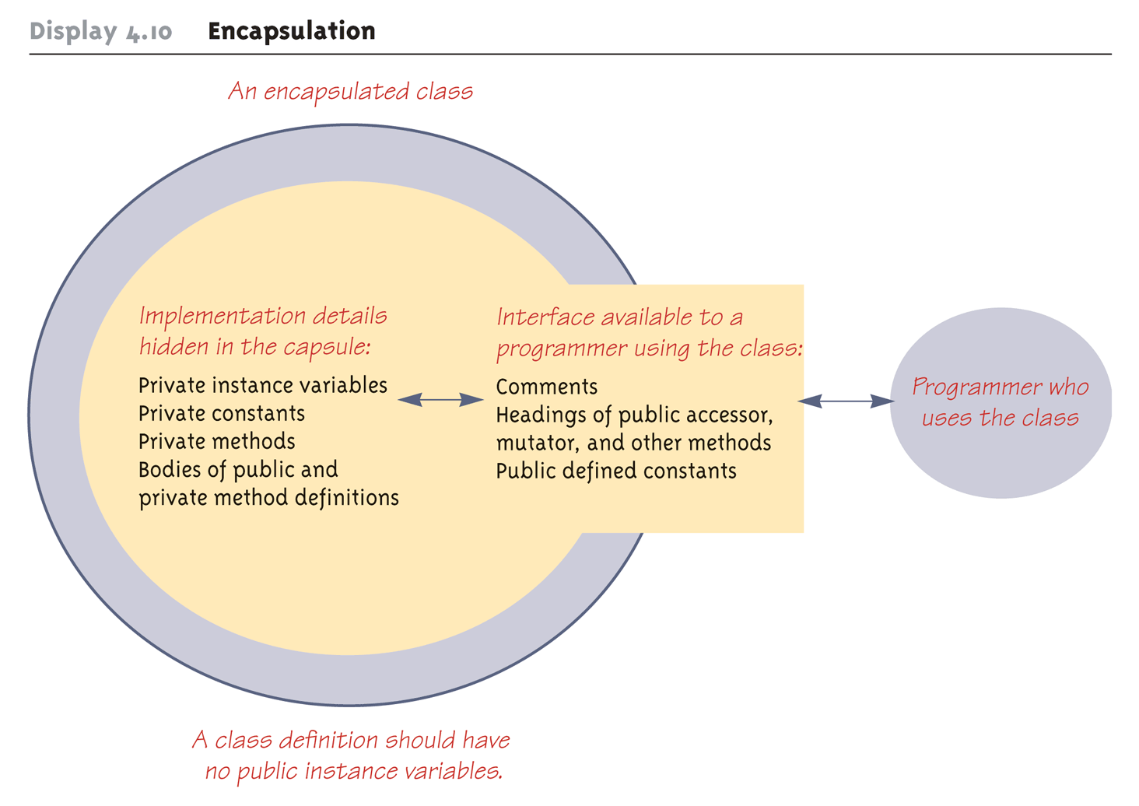
Encapsulation

Slide 44
public and private Modifiers
The modifier public means that there are no restrictions on where an instance variable or method can be used
Can be accessed outside the class
The modifier private means that an instance variable or method cannot be accessed by name outside of the class
It is considered good programming practice to make all instance variables private
Most methods are public, and thus provide controlled access to the object
Usually, methods are private only if used as helping methods for other methods in the class
Never invoked outside the class

Slide 45
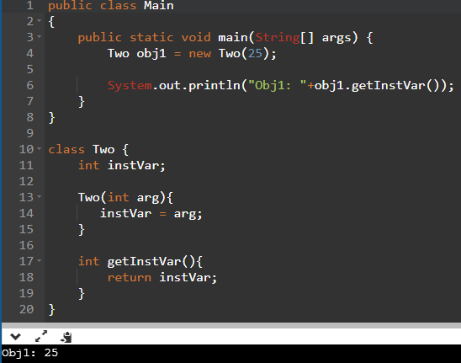
Example: access modifiers
“outside the class”
vs.
“inside the class”

Slide 46
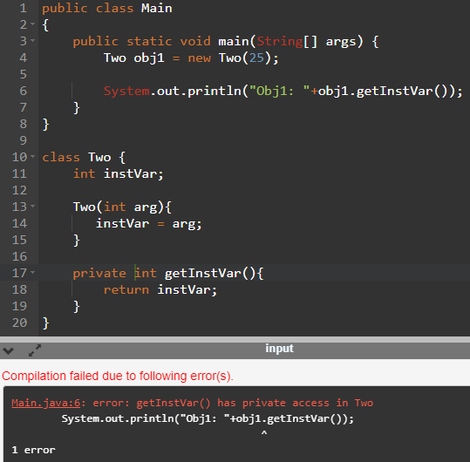
Example: access modifiers
“outside the class”
vs.
“inside the class”

Slide 47
A Class Has Access to Private Members of All Objects of the Class
Within the definition of a class, private members of any object of the class can be accessed, not just private members of the calling object

Slide 48
The methods equals and toString
Java expects certain methods, such as equals and toString, to be in all, or almost all, classes
The purpose of equals, a boolean valued method, is to compare two objects of the class to see if they satisfy the notion of "being equal"
Note: You cannot use == to compare objects
public boolean equals(ClassName objectName)
The purpose of the toString method is to return a String value that represents the data in the object
public String toString()

Slide 49
Local variables of the constructor
Treated as local variables of any other method

Slide 50
Parameters of a Primitive Type
If argument and parameter types do not match exactly, Java will attempt to make an automatic type conversion
In the preceding example, the int value of argument c would be cast to a double
A primitive argument can be automatically type cast from any of the following types, to any of the types that appear to its right:
byte→short→int→long→float→double
char

Slide 51
Parameters of a Primitive Type
A parameters is often thought of as a blank or placeholder that is filled in by the value of its corresponding argument
However, a parameter is more than that: it is actually a local variable
When a method is invoked, the value of its argument is computed, and the corresponding parameter (i.e., local variable) is initialized to this value
Even if the value of a formal parameter is changed within a method (i.e., it is used as a local variable) the value of the argument cannot be changed

Slide 52
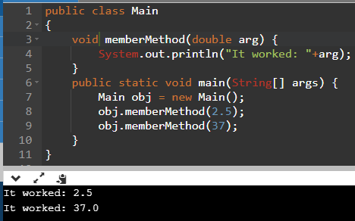
Example: Parameter Implicit Typecasting

Slide 53
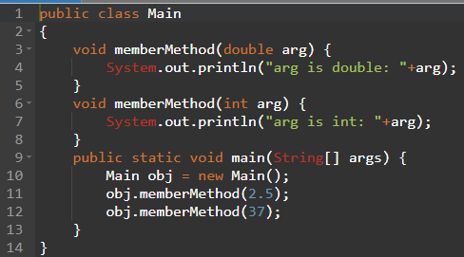
Example: Parameter Implicit Typecasting
A:
arg is double: 2.5
arg is double: 37.0
B:
arg is int: 2
arg is int: 37
C:
arg is double: 2.5
arg is int: 37

Slide 54
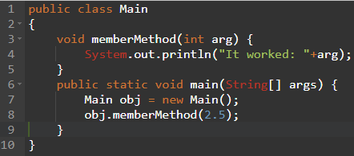
Example: Parameter Implicit Typecasting
A:
It worked: 2.5
B:
It worked: 2
C:
Compilation Error
D:
Runtime Exception

Slide 55
The this Parameter
All instance variables are understood to have <the calling object>. in front of them
If an explicit name for the calling object is needed, the keyword this can be used
myInstanceVariable always means and is always interchangeable with this.myInstanceVariable

Slide 56
The this Parameter
this must be used if a parameter or other local variable with the same name is used in the method
Otherwise, all instances of the variable name will be interpreted as local
int someVariable = this.someVariable
local
instance

Slide 57
The this Parameter
The this parameter is a kind of hidden parameter
Even though it does not appear on the parameter list of a method, it is still a parameter
When a method is invoked, the calling object is automatically plugged in for this

Slide 58
A Constructor Has a this Parameter
Like any ordinary method, every constructor has a this parameter
The this parameter can be used explicitly, but is more often understood to be there than written down
The first action taken by a constructor is to automatically create an object with instance variables
Then within the definition of a constructor, the this parameter refers to the object created by the constructor

Slide 59
Overloading
Overloading is when two or more methods in the same class have the same method name
To be valid, any two definitions of the method name must have different signatures
A signature consists of the name of a method together with its parameter list
Differing signatures must have different numbers and/or types of parameters

Slide 60
Overloading and Automatic Type Conversion
If Java cannot find a method signature that exactly matches a method invocation, it will try to use automatic type conversion
The interaction of overloading and automatic type conversion can have unintended results
In some cases of overloading, because of automatic type conversion, a single method invocation can be resolved in multiple ways
Ambiguous method invocations will produce an error in Java

Slide 61
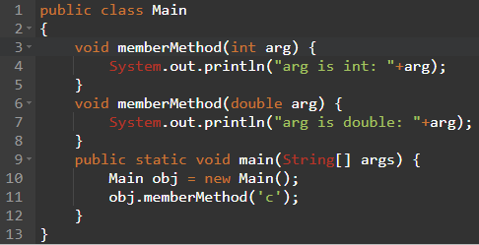
Example
A:
arg is double: 99.0
B:
arg is int: 99
C:
Compilation Error
D:
arg is int: c

Slide 62
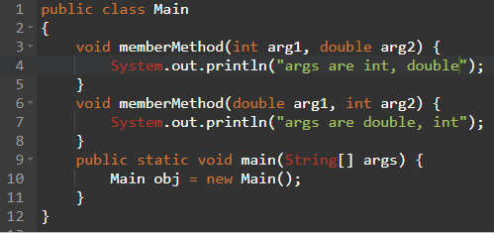
Example: Overloading
A:
Not an Error
B:
Compilation Error

Slide 63
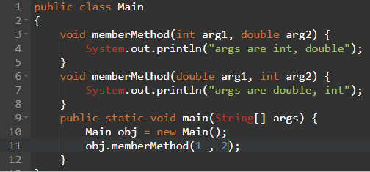
Example: Overloading
A:
args are int, double
B:
args are double, int
C:
Compilation Error

Slide 64
Pitfall: You Can Not Overload Based on the Type Returned
The signature of a method only includes the method name and its parameter types
The signature does not include the type returned
Java does not permit methods with the same name and different return types in the same class

Slide 65
You Can Not Overload Operators in Java
Although many programming languages, such as C++, allow you to overload operators (+, -, etc.), Java does not permit this
You may only use a method name and ordinary method syntax to carry out the operations you desire

Slide 66
Include a No-Argument Constructor
If you do not include any constructors in your class, Java will automatically create a default or no-argument constructor that takes no arguments, performs no initializations, but allows the object to be created
If you include even one constructor in your class, Java will not provide this default constructor
If you include any constructors in your class, be sure to provide your own no-argument constructor as well

Slide 67
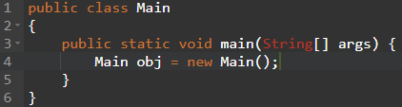
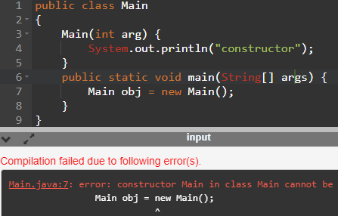
Example

Slide 68
Default Variable Initializations
Instance variables are automatically initialized in Java
boolean types are initialized to false
Other primitives are initialized to the zero of their type
Class types are initialized to null
However, it is a better practice to explicitly initialize instance variables in a constructor
Note: Local variables are not automatically initialized

Slide 69
Reading
Read the complete chapter 4
It is REQUIRED
Practice self test exercise and end problems

